Slide 1

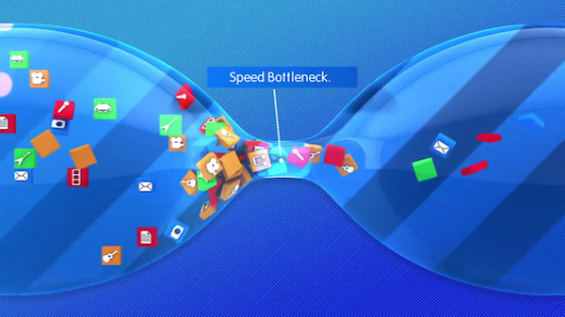
Thus, for this simple two-link network, the throughput is min{Rc, Rs}, that is, it is the transmission rate of the bottleneck link.
Simile
By Computer Networking A Top-Down Approach Sixth Edition Page 71.

Slide 2
Can you can a can as a canner can can a can？ Coca Cola, PayPal, BestBuy…….. and more.
Alliteration
By a English Tongue twister

Slide 3
Packet-switched networks (which transport packets) are in many ways similar to transportation networks of highways, roads, and intersections (which transport vehicles).
Simile
By Computer Networking A Top-Down Approach Sixth Edition Page 4.

Slide 4
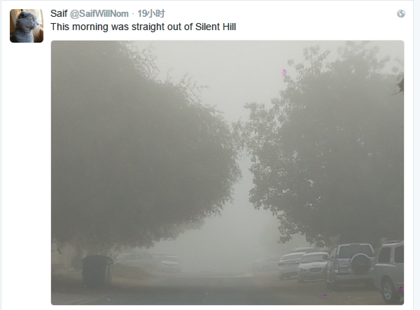
This morning was straight out of Silent Hill.
Hyperbole
By Someone’s tweet.

Slide 5
“Family is a sinkhole, and you were right to get out when you had the chance.”
metaphor
By Bojack Horseman S1E5 said to Diane .

Slide 6
There ain't no excuse for coming up short, the ‘ball is in your court’.
IDIOM
By *NSYNC -Do Your Thing.

Slide 7
Can’t make a nest without breaking a few eggs.
Clichés
By Batman The killing joke 2016.
有得必有失

Slide 8
Dressing up like a flying rat doesn’t hide it , it screams it.
Metaphor
By Batman The killing joke 2016.

Slide 9
“ ‘Make the seconds count’ ,baby ,every one.”
Idiom
By Childhood End Part.2.

Slide 10
Using our house/door analogy for a process/socket, we will sometimes refer to the client’s initial contact as “knocking on the welcoming door.”
Personification
By Computer Networking A Top-Down Approach Sixth Edition Page 163.

